Slide 1
Airfoil Design Optimization
Andrew Smith
BS/MEng in Mechanical Engineering

Slide 2
Project Overview & Agenda
Problem Definition
Proposed Solution
Learning Algorithms
Results & Visualization
Geometry Comparison
Areas for Investigation

Slide 3
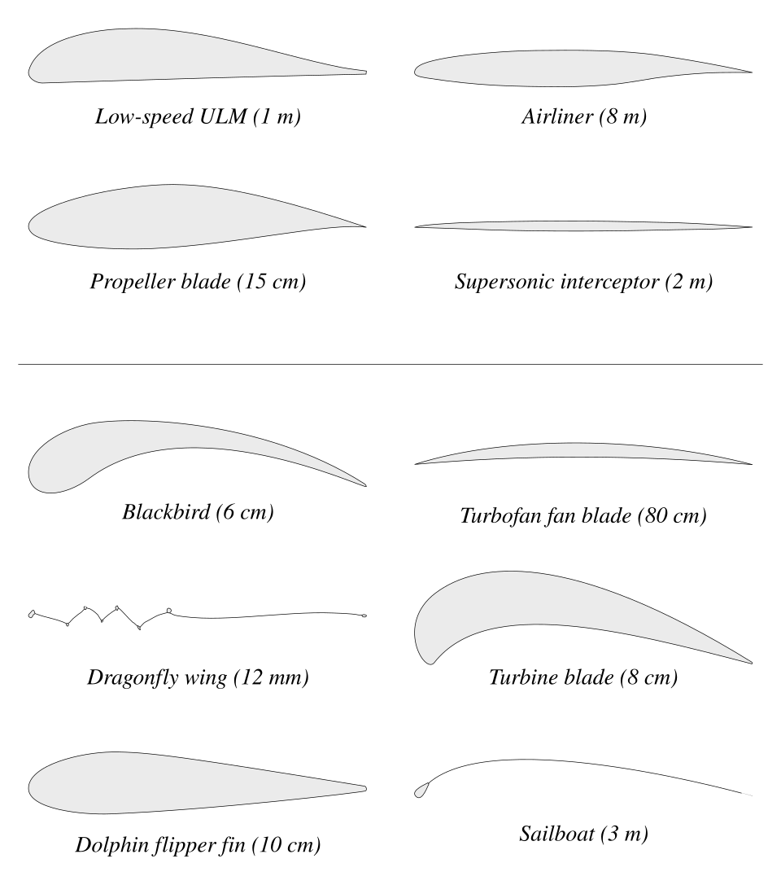
Problem Definition
How do we pick an airfoil shape that is best suited for a specific application?
Importance:
Air-travel accounts for ~2.5% of global CO2 emissions.
Demand for air-travel has increased from 1.6 billion to 5.0 billion passengers annually between 2000 and 2024.
Optimized airfoil geometry can reduce fuel expenditure by 20 to 25%.
Notes:
Applications in wind turbines
Applications in biology

Slide 4
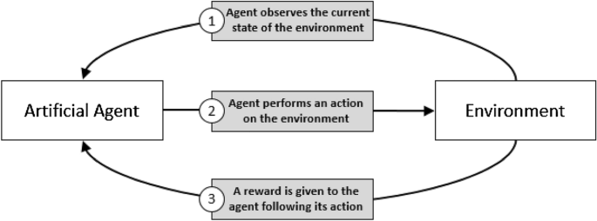
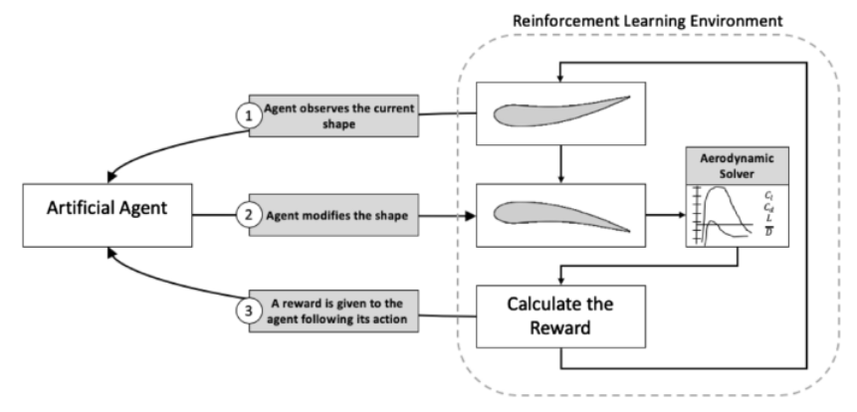
Proposed Solution
Use Reinforcement Learning!
Create a custom gym environment for generating, simulating, and evaluating airfoil geometries.
Allow RL agents to act on the environment and search for an optimal solution.

Slide 5
Proposed Solution - Environment & Agents
Initialize:
Setup observation space
Setup action space (8D continuous)
Initialize state (symmetric airfoil)
Step:
Apply action to state
Generate airfoil geometry (bezier curves)
Evaluate geometry (XFOIL)
Calculate reward (L/D ratio)
Render:
Not used
Reset:
Resets to initial state
Soft Actor-Critic (SAC):
Off policy
Continuous action space
Model free
Stochastic
Deep Deterministic Policy Gradient (DDPG):
Off policy
Continuous action space
Model free
Deterministic

Slide 6
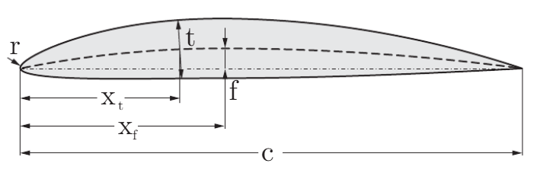
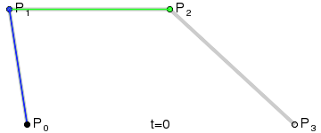
Proposed Solution - 4-Digit NACA vs. Bezier Parameterization
4-Digit NACA:
1st digit: maximum camber as a percentage of the chord length (f/c).
2nd digit: Location of maximum camber along the chord line from the leading edge (xf/c).
3rd and 4th digits: Maximum thickness as a percentage of chord length (t/c).
Bezier Curve Parameterization:
Upper and lower surfaces defined by control points.
For this project:
8 control points
x-position fixed
y-position varies
8D continuous action space
Notes:
National Advisory Committee for Aeronautics (NACA)

Slide 7
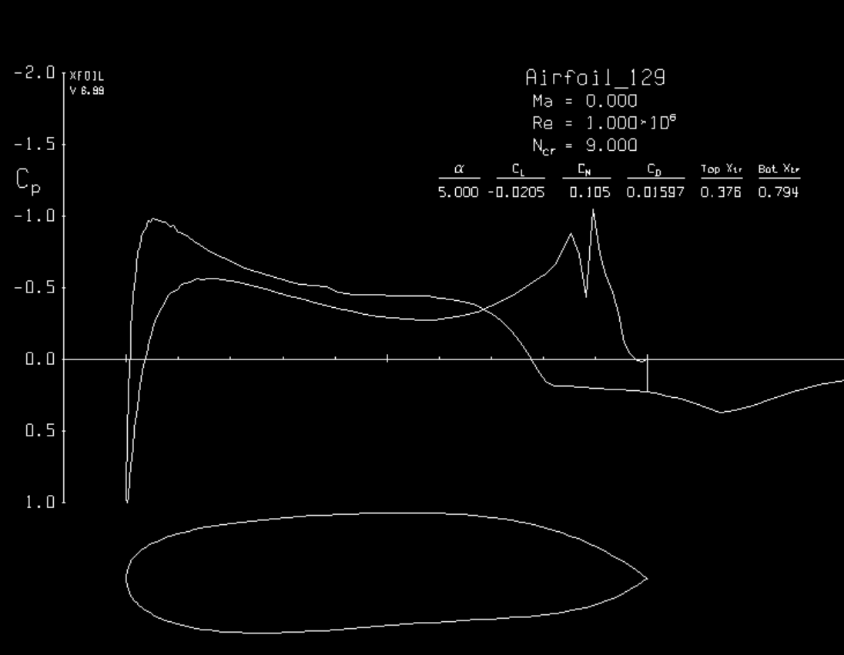
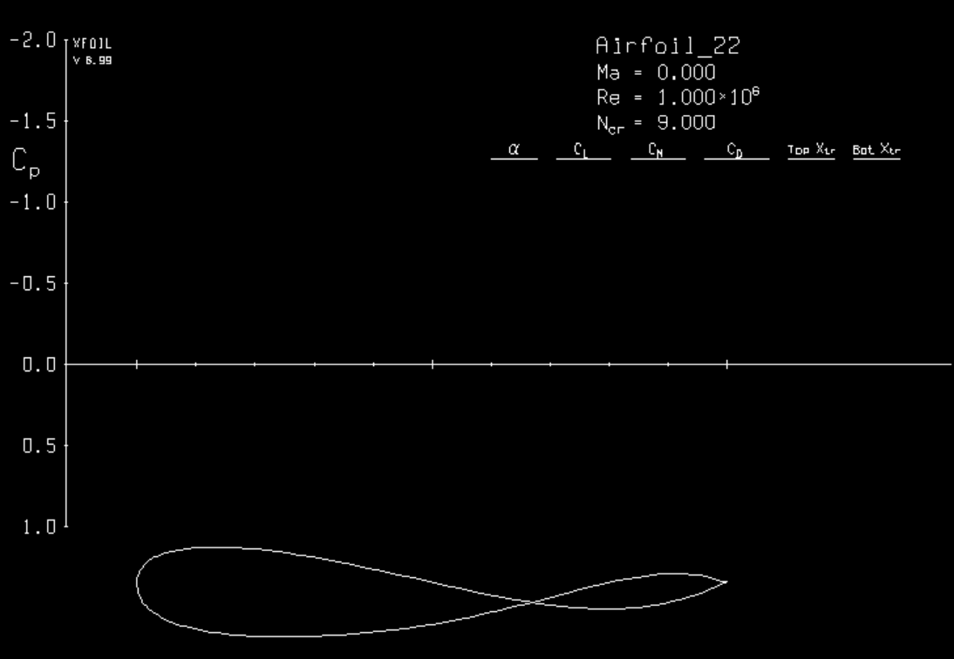
Proposed Solution - Evaluate Using XFOIL
What is it?
Developed in the 1980s by Mark Drela, XFOIL is a computational fluid dynamics (CFD) software that evaluates performance metrics of 2D airfoils.
Inputs:
Airfoil geometry (.dat file)
Angle of attack (5-7 deg)
Reynolds number (1.0e6)
Iterations (250)
Outputs:
Lift coefficient (CL)
Drag coefficient (CD)
Challenges:
Simulation runtime (~1.5s per sim)
Does not always converge
Prone to crashing
Bad Geometry
Self Intersection
Notes:
2-5 cruising
~7 climbing
10-12 landing/takeoff
15-20 stall

Slide 8
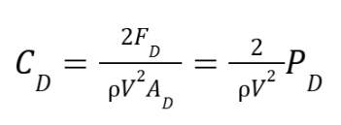
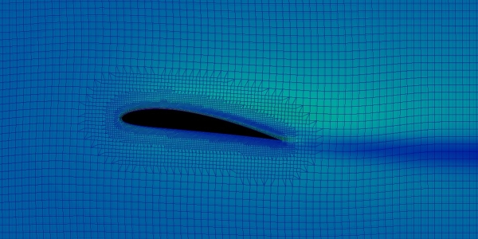
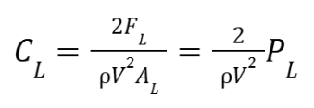
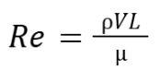
Proposed Solution - Evaluate Using XFOIL
How XFOIL calculates performance metrics:
Discretize the space and solve using Finite Element Methods (FEM)

Slide 9
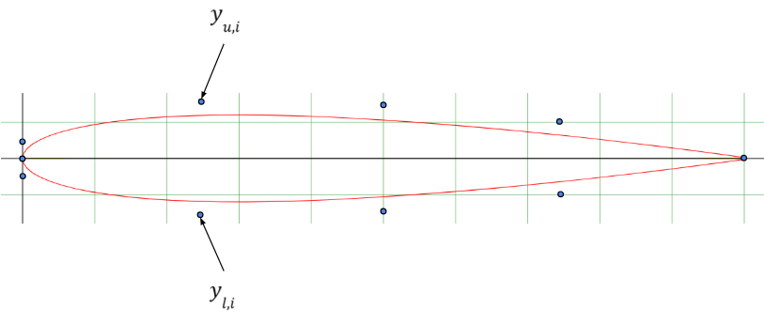
Proposed Solution - Environment
Initialization:
Action Space:
± 0.15 for 8D space.
Observation Space:
0.05 to 0.15 for upper leading point
-0.15 to -0.05 for lower leading point
± 0.15 for all other points
Initial State:
0.1 for upper points
-0.1 for lower points
L/D: 24.24
Step:
Apply action and update state (clip to observation).
Check for simulation stability
If self intersection or points too close (0.025):
Do not run simulation
Reward = 0
Otherwise:
Reward = average L/D ratio

Slide 10
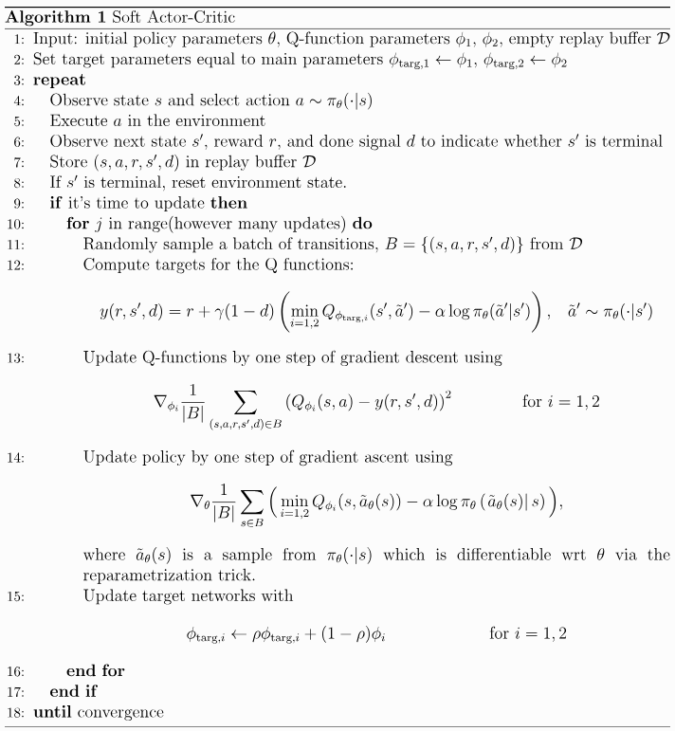
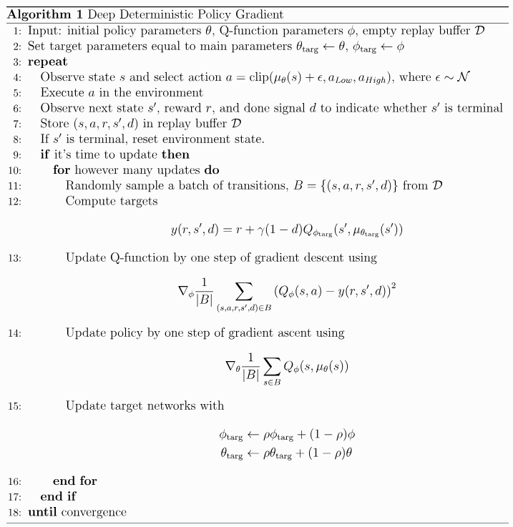
Learning Algorithms
Soft Actor Critic (SAC)
Deep Deterministic Policy Gradient (DDPG)

Slide 11
Learning Algorithms
Soft Actor Critic (SAC)
Learning starts: 512*
Batch size: 128*
Learning steps: 4096*
SB3 wrapper used to implement
Deep Deterministic Policy Gradient (DDPG)
Learning starts: 1024*
Batch size: 128*
Learning steps: 4096*
SB3 wrapper used to implement

Slide 12
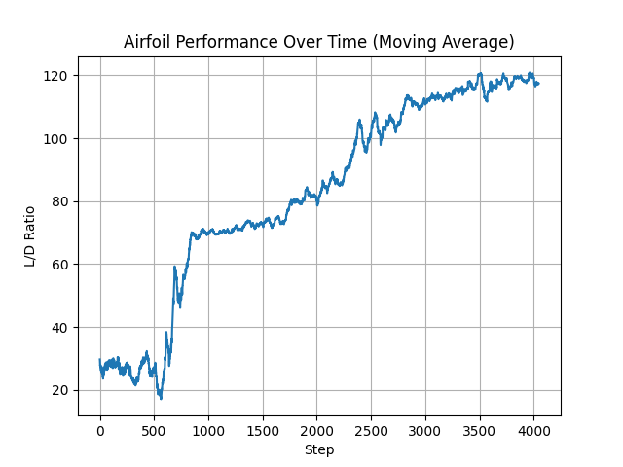
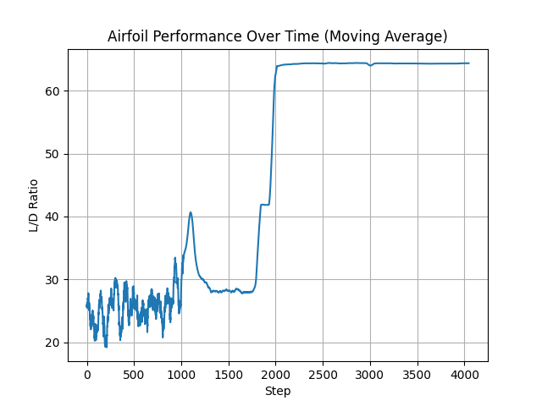
Results & Visualization - Convergence
Soft Actor Critic (SAC)
Deep Deterministic Policy Gradient (DDPG)
L/D Ratio: 121.59
L/D Ratio: 66.72

Slide 13
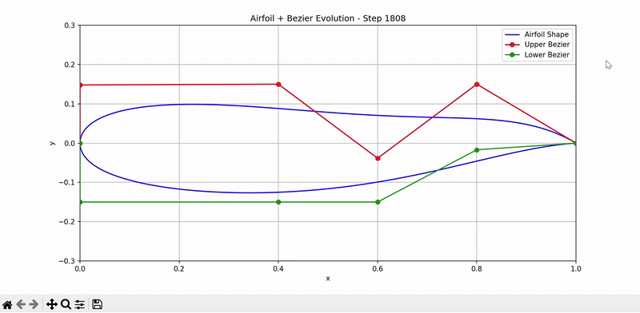
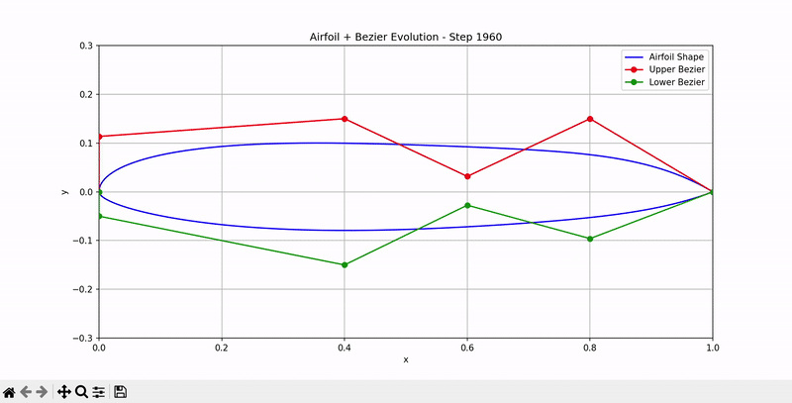
Results & Visualization - Convergence
Soft Actor Critic (SAC)
Deep Deterministic Policy Gradient (DDPG)
Gradual Stochastic Convergence
Sudden Deterministic Convergence

Slide 14
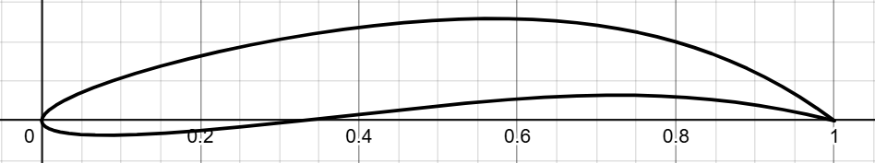
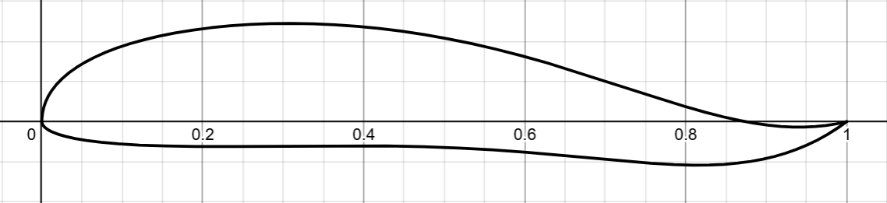
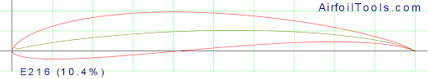
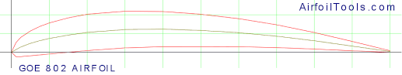
Geometry Comparison
Soft Actor Critic (SAC)
(L/D: 121.59)
Deep Deterministic Policy
Gradient (DDPG)
(L/D: 66.72)
SG6043 Airfoil
(L/D: 128.79)
NACA 6409 Airfoil
(L/D: 144.85)
Notes:
Selig / Giguere for wind turbines

Slide 15
Areas for Investigation
Control Points:
Spacing
Degrees of freedom
Action and Observation Constraints:
Upper bound
Lower bound
Loosen/tighten constraints
Hyperparameter Tuning:
Batch size
Learning starts
Learning steps
Simulation Parameters:
Angle of attack
Reynolds number
Iterations
Optimization Strategy:
Proximal Policy Optimization (PPO)
Twin Delayed Deep Deterministic Policy Gradient (TD3)
Geometric Parameterization:
NACA 4-digit
Class-shape transformation (CST)
Parametric equation concept (PARSEC)

Slide 16
References
https://doi.org/10.1016/j.ast.2025.110638
https://doi.org/10.1038/s41598-023-36560-z
https://doi.org/10.3846/aviation.2022.16471
https://web.mit.edu/drela/Public/web/xfoil/
https://stable-baselines3.readthedocs.io/en/master/index.html
https://github.com/as5652/airfoil-design-optimization

Slide 17
Thank you!

Slide 18
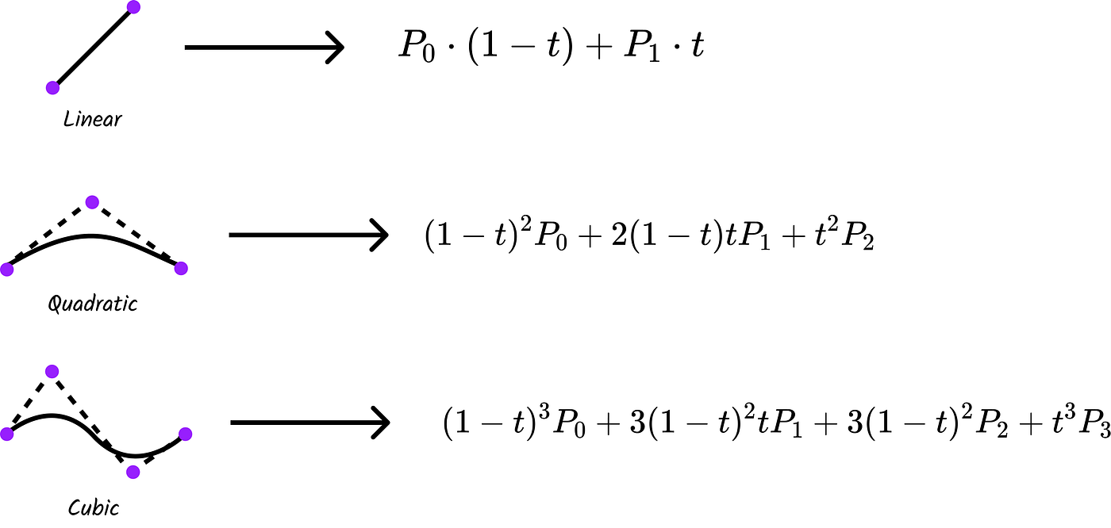
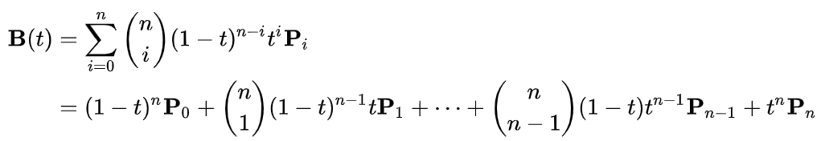

Slide 19
